Slide 1






Anticipating Events based on events An ML Approach
BEST OF SHOW

Slide 2
Whats the Goal?
Predict future events, a company will be involved in.
Week 1
Investigation
Plant Closure
Week 2
Lawsuit
CEO Stepping Down
Week 3
Restructure
Stock Price Down

Slide 3
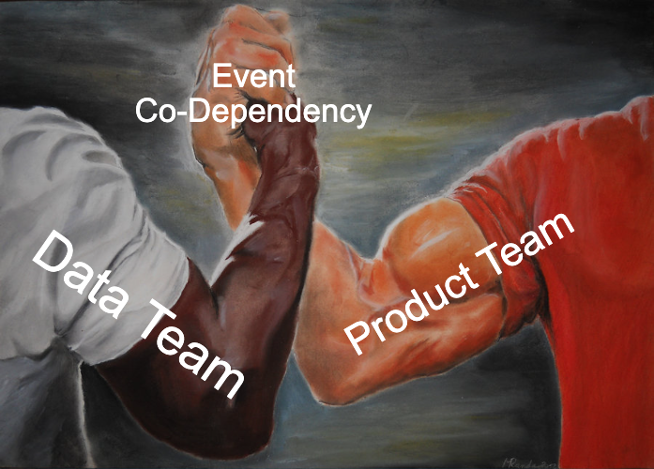
Whats the Goal?
Predict future events, a company will be involved in.
Similar to Maja‘s and Anna‘s previous work on Event Co-dependency
shifting from linguistic to product Fokus

Slide 4
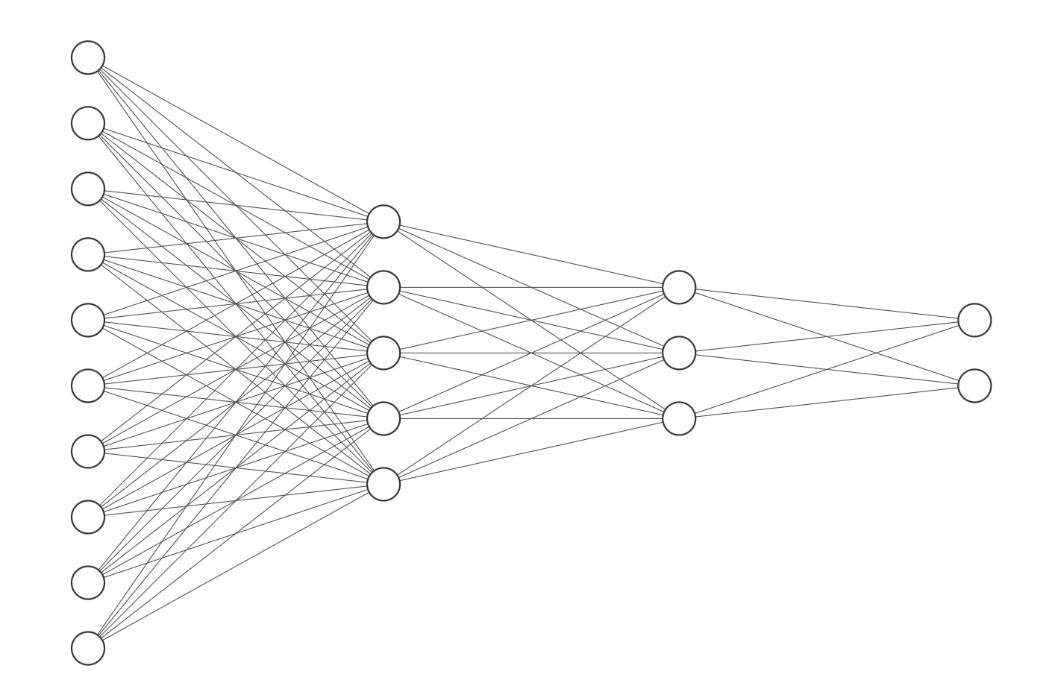
Multilayer Neural Network
Structure
Data : Apple news events frequency per date
Train : 2020-01-01 -> 2023-07-10
Test : 2023-07-10 -> 2024-07-21
Input Layer
1285 (dates) x 119 (events)
Original input :
On 2023-07-01, 'Product Launch' appeared 198 times
One-hot encoding input:
If 'frequency' (on a date) >= median (of all dates)
- 'Product Launch' 'Product Launch' = 1 (on a date)
- Otherwise 'Product Launch' = 0 (on a date)
Hidden Layer 1
119 x 1000
Hidden Layer 2
1000 x 64
Output Layer
64 x 2 (binary yes-1/no-0)
Example :
Event 'Stock Price Up' (1/0)
Event 'Stock Price Down' (1/0)

Slide 5
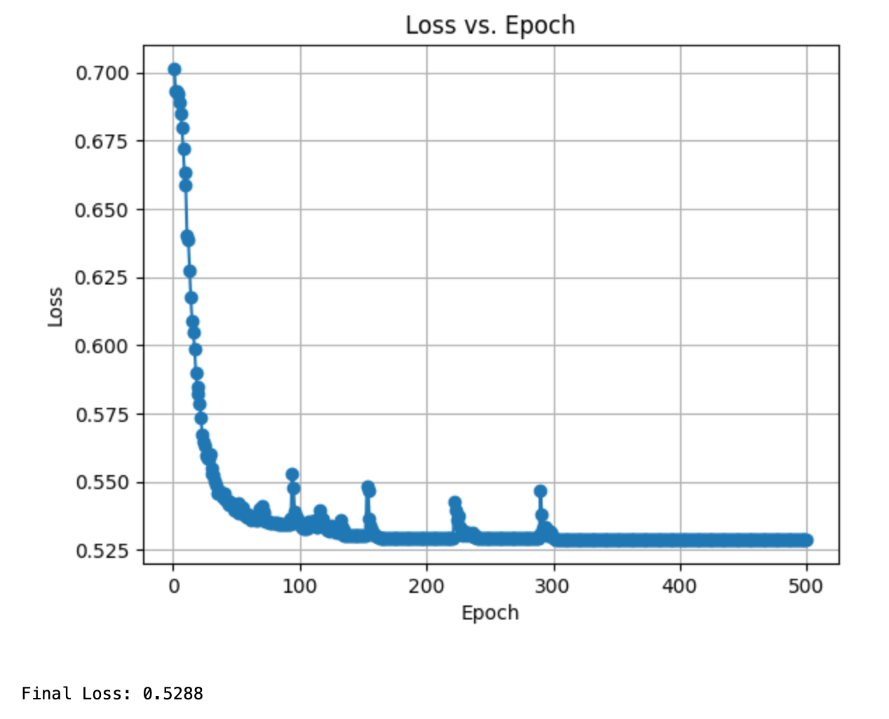
Hyperparameters Tuning
Multilayer Neural Network
Optimal Parameters
(lower loss value preferred)
n_epochs = 250
batch_size = 5
hidden_layers = [1000, 64]
Activation = relu
Loss <= 0.528
Loss tends to be stable as number of epoch approaches 500
But if it getting too big, there will be potential overfitting problem
BCEWithLogitsLoss for multi-label classification BCE(p,y)=−[y*log(p)+(1−y)*log(1−p)]

Slide 6
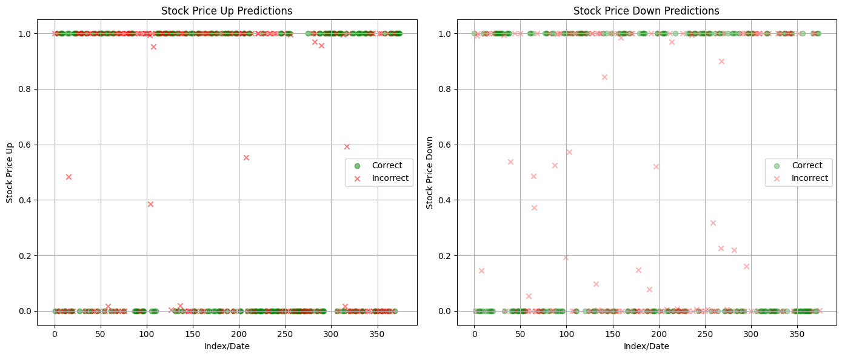
Model Performance
Model Performance Evaluation
1-yes
0-No
 | Up | Down | Overall
Accuracy | 57% | 58% | 58%
Precision | 56% | 59% | 57%
Recall | 62% | 54% | 58%

Slide 7
Future Outlook
Limitation & Improvement
This is just a start ...
Universe : Train with data from more companies
Current model is trained by Apple data only
Model : Try Long Short-term Memory Model (LSTM)
LSTM uses wider time frame data to make prediction
Allow sequences of data instead of individual points
Different Event outputs:
Predict more events than just stock price
Feature Engineering:
Change Binary approach, as its dropping information

Slide 8
Thank you everyone! :)

